Slide 1
AGILE TEAM
Project by Jay Patil

Slide 2
Objectives of Agile Team
1 - Individuals and interactions over processes and tools
The first value emphasizes teamwork and communication.Tools are an important part of software development, but making great software depends much more on teamwork, regardless of the tools the team may use.
2 - Working software over comprehensive documentation
The main goal of software development is to develop software that offers business benefits rather than extensive documentation.
3 - Customer collaboration over contract negotiation
Development teams must work closely and communicate with their customers frequently. By listening to and getting feedback, teams will understand what all stakeholders really want.
4 - Responding to change over following a plan
Changes are a reality in Software development, a reality that your Software process should reflect. A project plan must be flexible enough to change, as the situation demands.
With the collective points above the Agile team should be able to communicate with the other two teams seamlessly to achieve the goal of releasing the scalable payment microservice in stipulated timeline & quality.

Slide 3
Responsibilities of Roles in Agile
Tech Lead - Tech Leads are responsible for managing technical aspects of software development flow in a specific context or team. It's crucial to a good tech lead to ensure the success of delivered solutions. In other words, tech leads are software engineers that enable the team to work with quality
Developer - Agile developers take responsibility for estimating, planning and managing all tasks and report on progress. Software quality. The Agile developer is also responsible for the quality of the software he/she produces.
QA Engineer - QA helps to proactively address issues and potential bugs within an application during the development cycles. It can also help address functionality, performance, or security issues
DevOps Engineer - The role of a devOps engineer combines aspects of a technical role and an IT operations role. While engineers are likely to be involved with coding, and a knowledge of coding languages and principles is required to find problems and build solutions, this is not the primary role of a devOps engineer
Support Engineer - Document and escalate more complex issues to higher level technical teams internally and externally

Slide 4

The Agile team as a whole is accountable for the project results. However in case of team outside the Scrum a RACI matrix/chart is recommended.
RACI chart helps to clarify roles and responsibilities in cross-functional/departmental projects and processes.
R - Responsible
A - Accountable
C - Consulted
I - Informed

Slide 5
RACI Matrix
 | Release Planning | Sprint Kick Off | Sprint Execution - Delivery | Sprint End Acceptance | Release
Product Owner | R | R | R | A | I
Team Lead | C | C | R | R | C
Scrum Master | R | A | C | I | I
Scrum Team Member | C | C | A | C | C
Ops Manager | I | I | C | C | R
Roles
Process
R = Responsible, A = Accountable, C = Consulted & I = Informed
NOTE - Organizations usually tweak this chart to fit their own context.

Slide 6
List of KPI’s
Time KPIs
Cycle time
Lead time
Resource capacity
Schedule performance index
On-time completion percentage
Time spent
Scheduled hours vs. time spent
Budget KPIs
Actual cost (AC)
Earned value (EV)
Cost performance index (CPI): Formula: CPI = EV/AC; CPI = 1
Cost variance
Planned cost
Planned value
Effectiveness KPIs
Number of project milestones completed and signed on time
Number of change requests
Quality KPIs
Number of errors
These are the list of KPI’s we can use to achieve the Agile objective. It is not necessary to use all of them and can be chosen according to the stage and requirement. There are plethora and broader KPI’s that can be of use to measure the performance assessment first on the next slide…...

Slide 7
The key metrics we must explore first are…..
Work In Progress
Velocity
Sprint Burndown
Release Burndown
Process Health & Bottlenecks
Cycle Time
Cumulative Flow
Flow Efficiency
Code Quality
Automated VS Manual Test
Code Coverage
Code Churn

Slide 8
We can measure the KPI’s and share the success via the reports using below plugins in Jira. Some of them are free to use while some are paid. A few are listed below -
Easy BI Charts (Dashboard/BI Tool)
Custom Charts for JIRA (Dashboard/BI Tool)
Charts & Graphs for BitBucket (CI/CD Dashboard Tool)
Aha! Roadmaps for JIRA (Product Roadmap Tool)
Tempo Timesheets (Time Tracking Tool)
Apart from these tools there are other 3rd Party Tools that can be used to maximise the efficiency and the reporting apart from the one’s in Jira/Confluence.

Slide 9
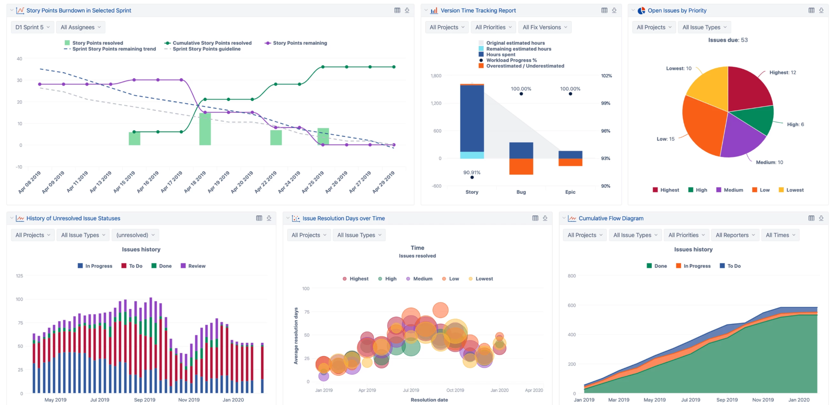
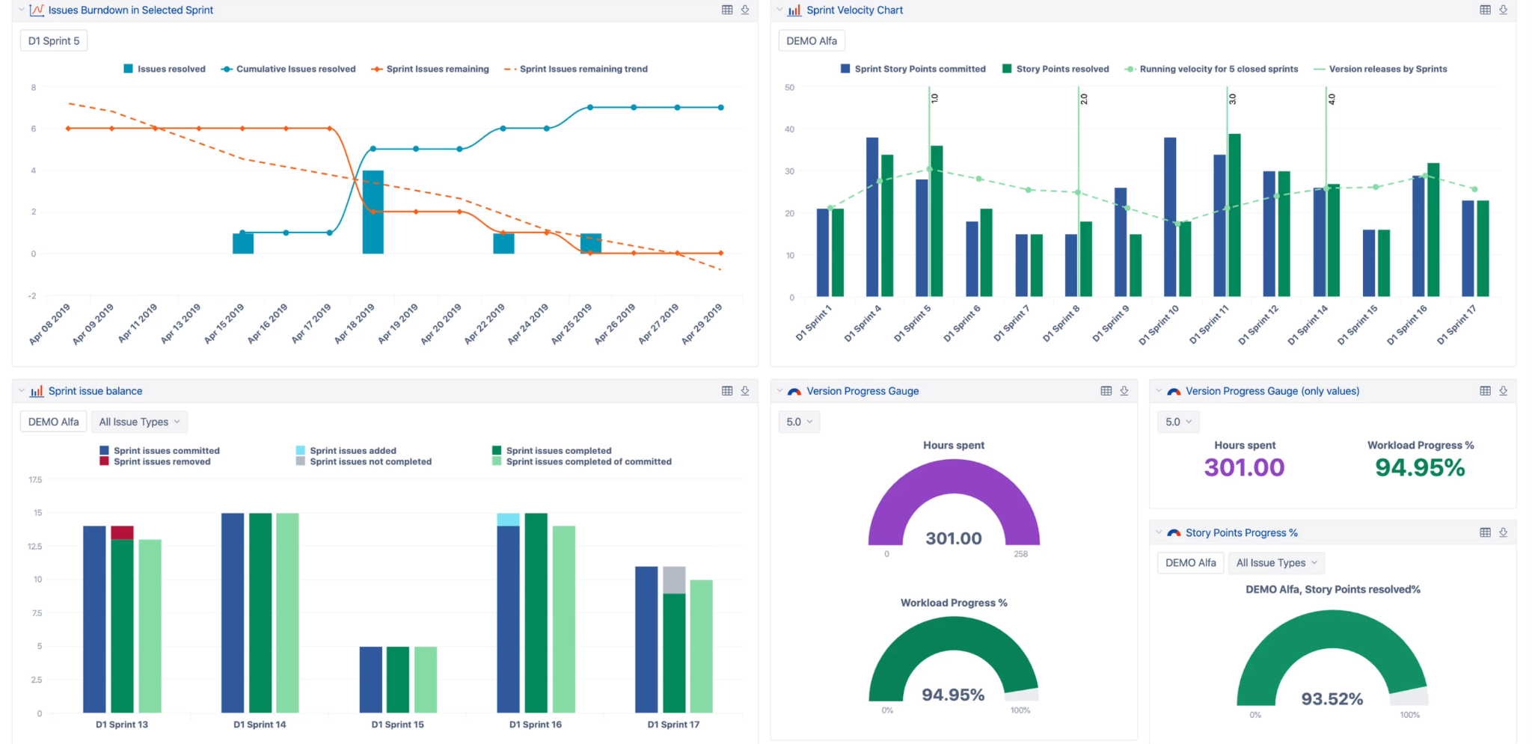
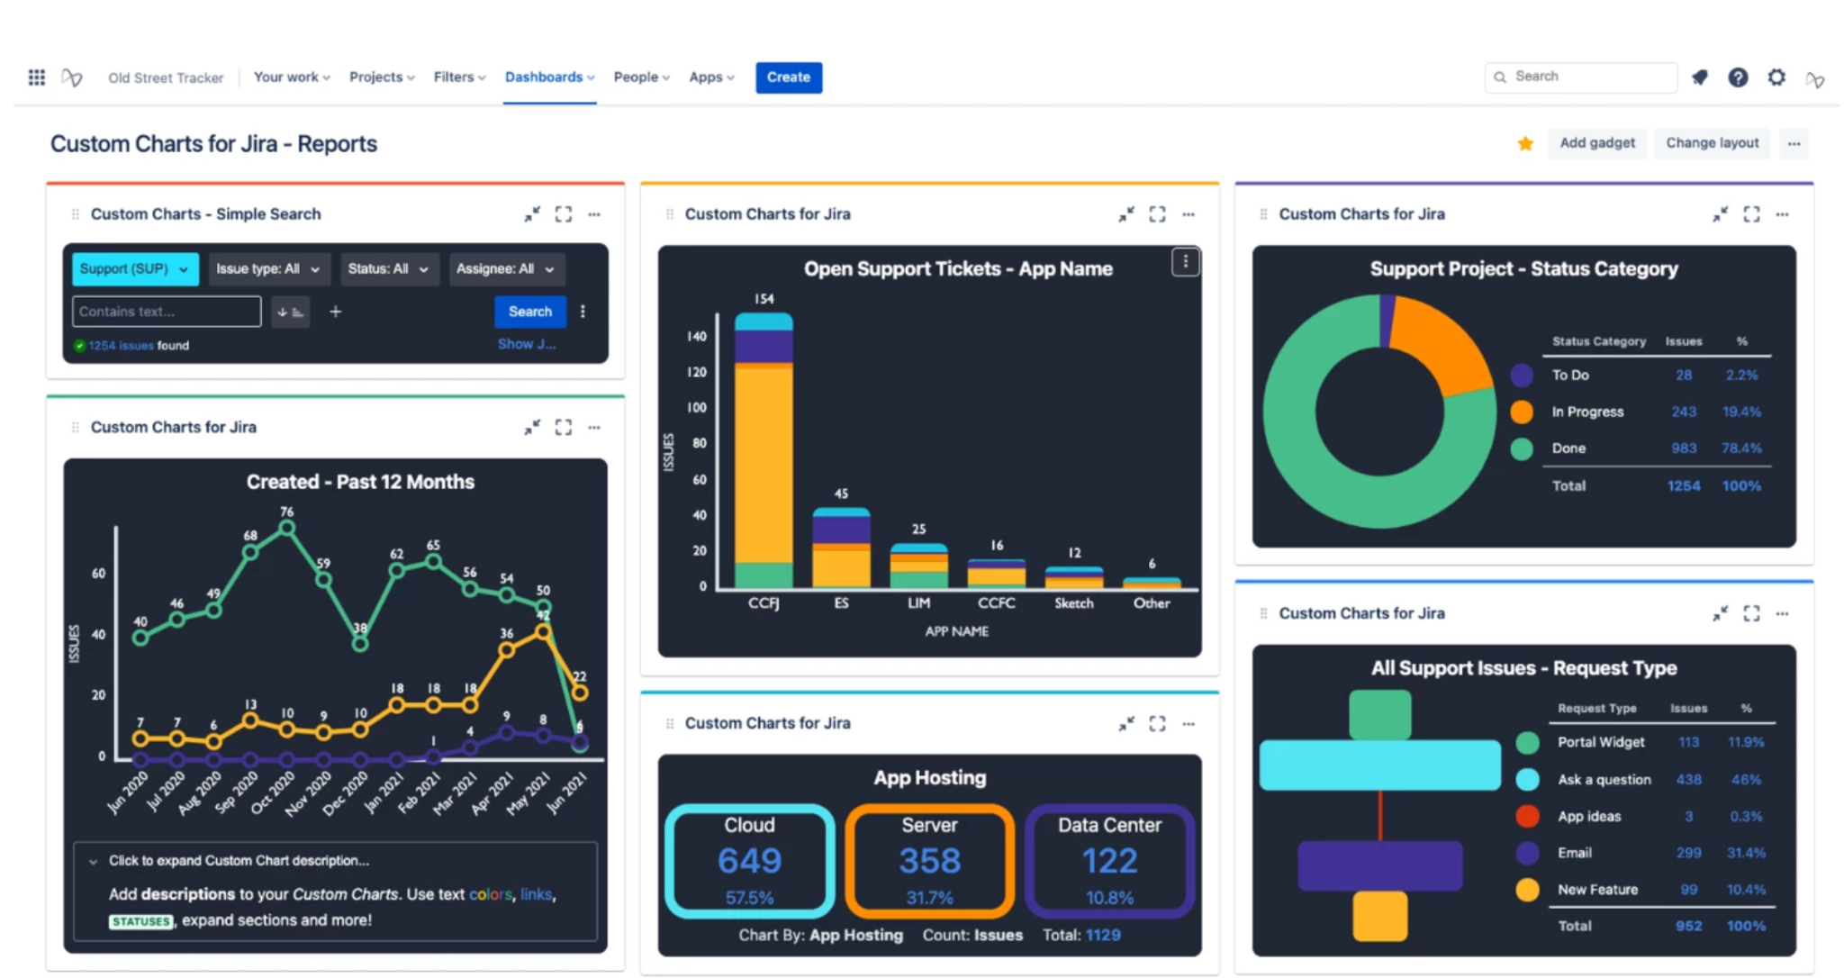
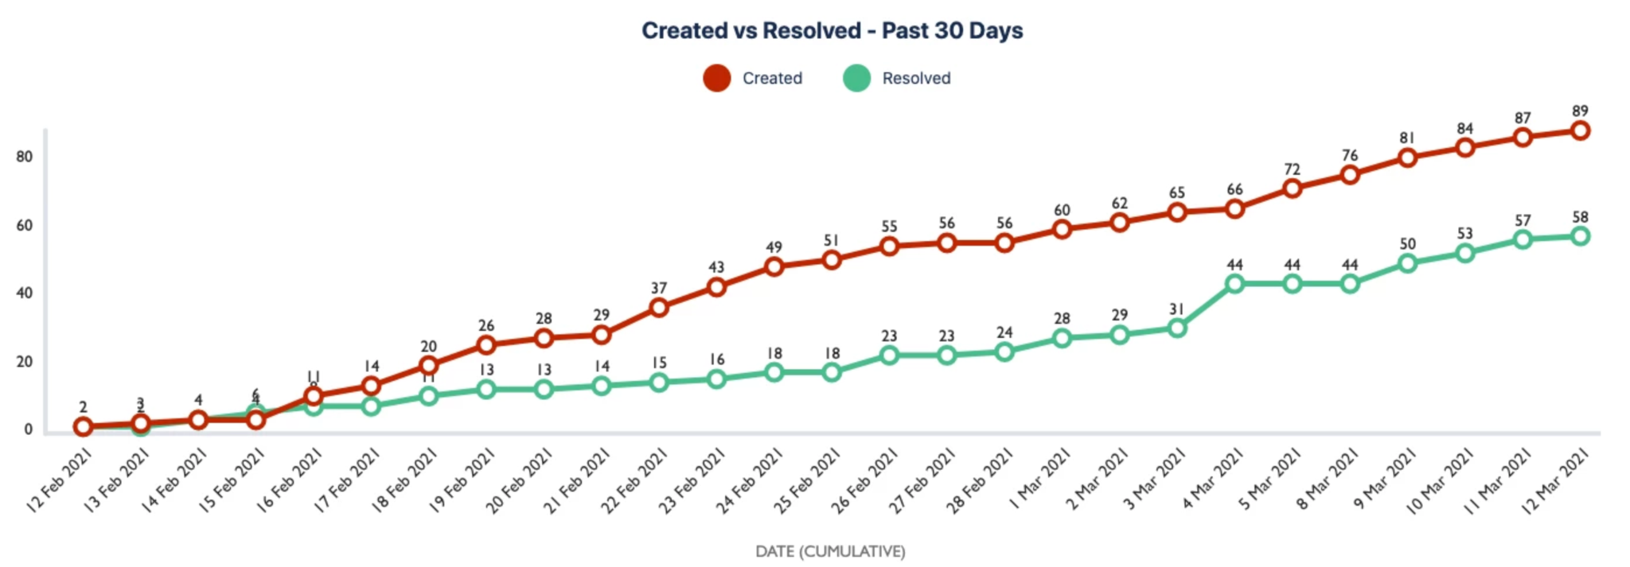
Look & Feel of the Tools
Easy BI Charts
Custom Charts for JIRA

Slide 10
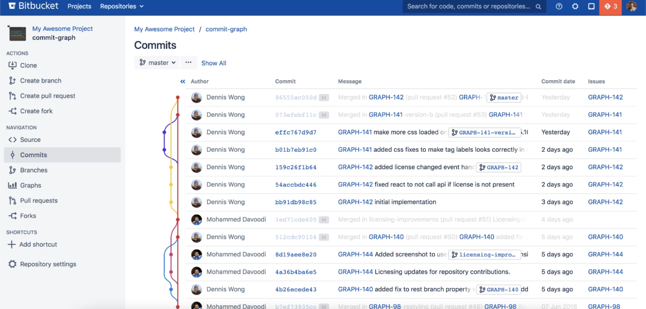
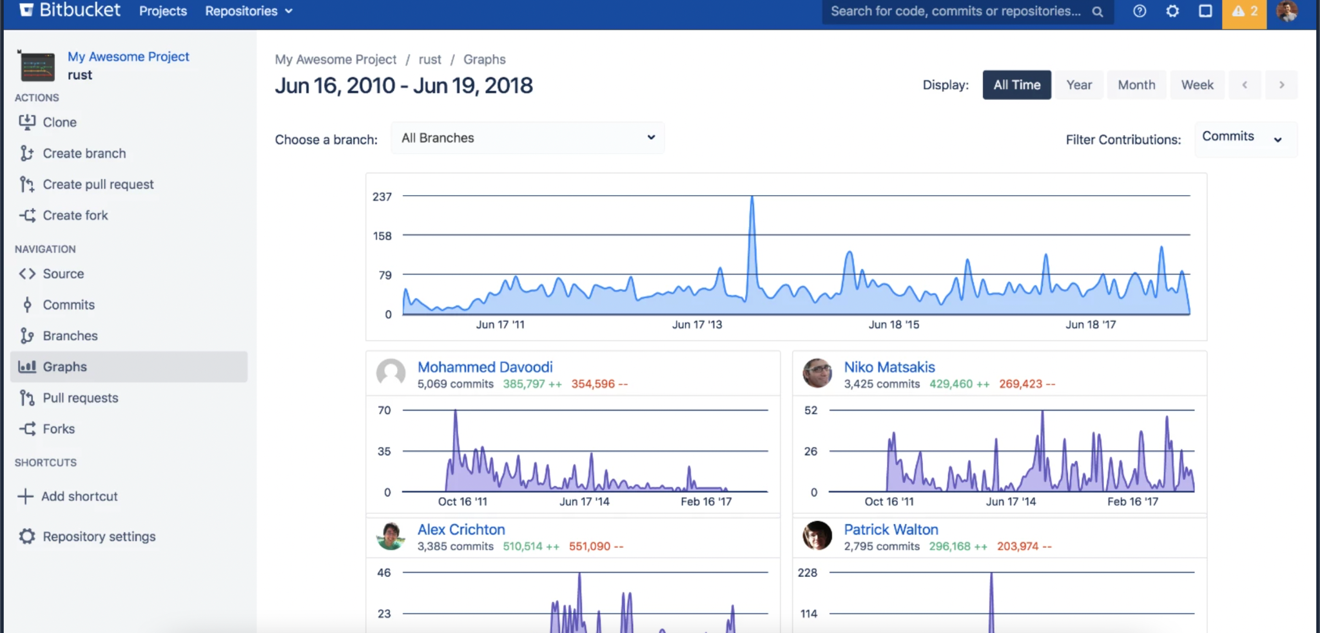
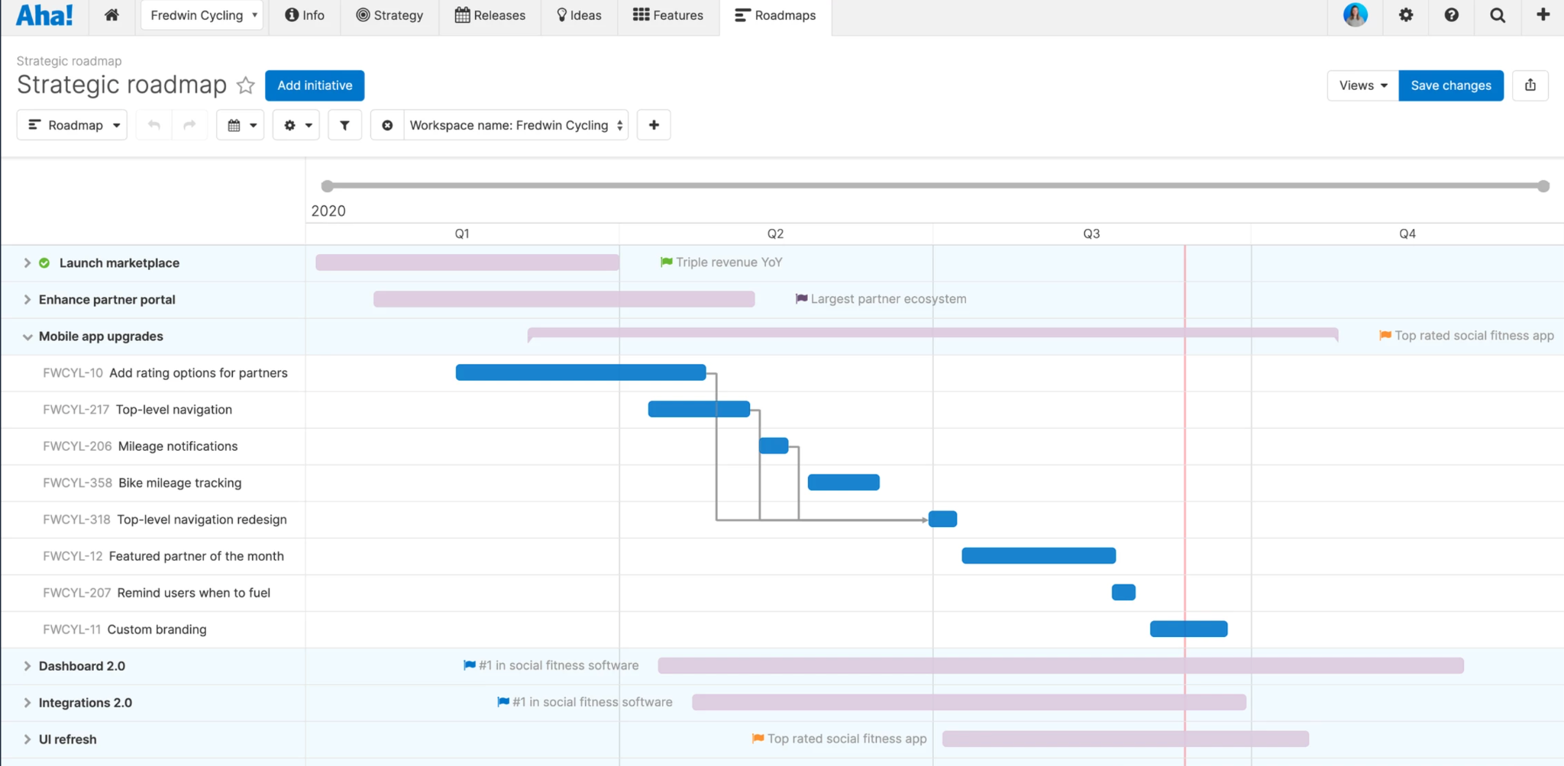
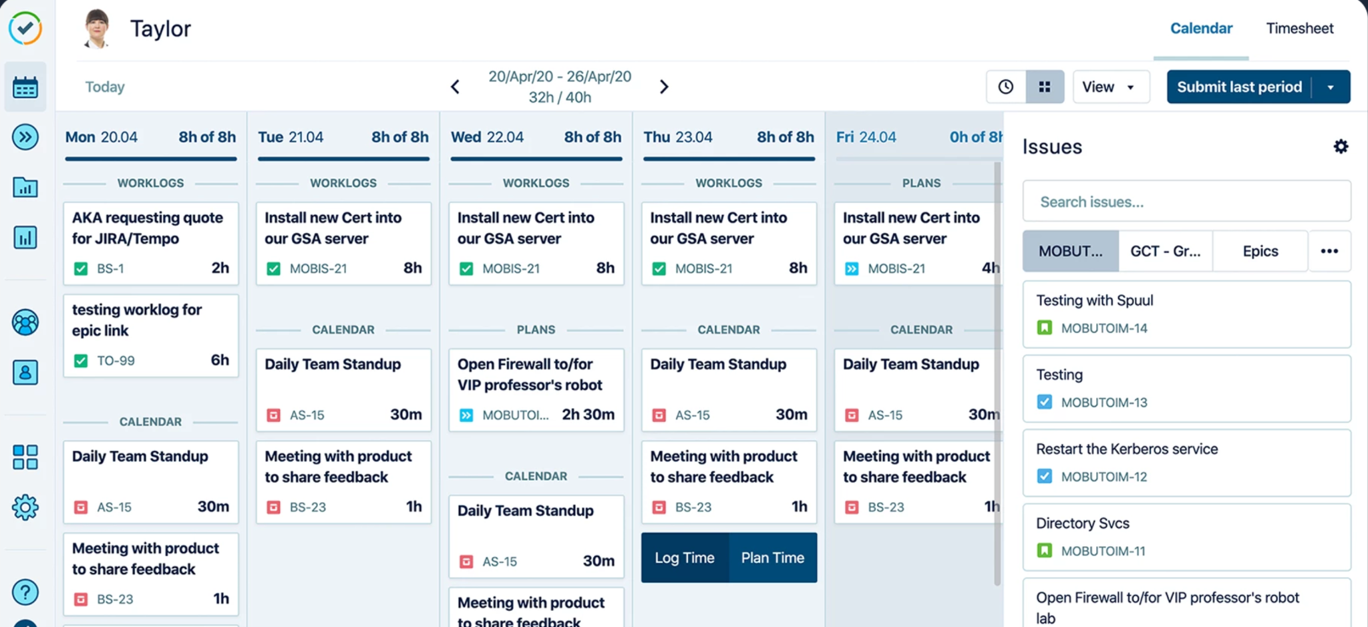
Charts & Graphs for BitBucket
Tempo Timesheet
Aha! Roadmaps for JIRA

Slide 11

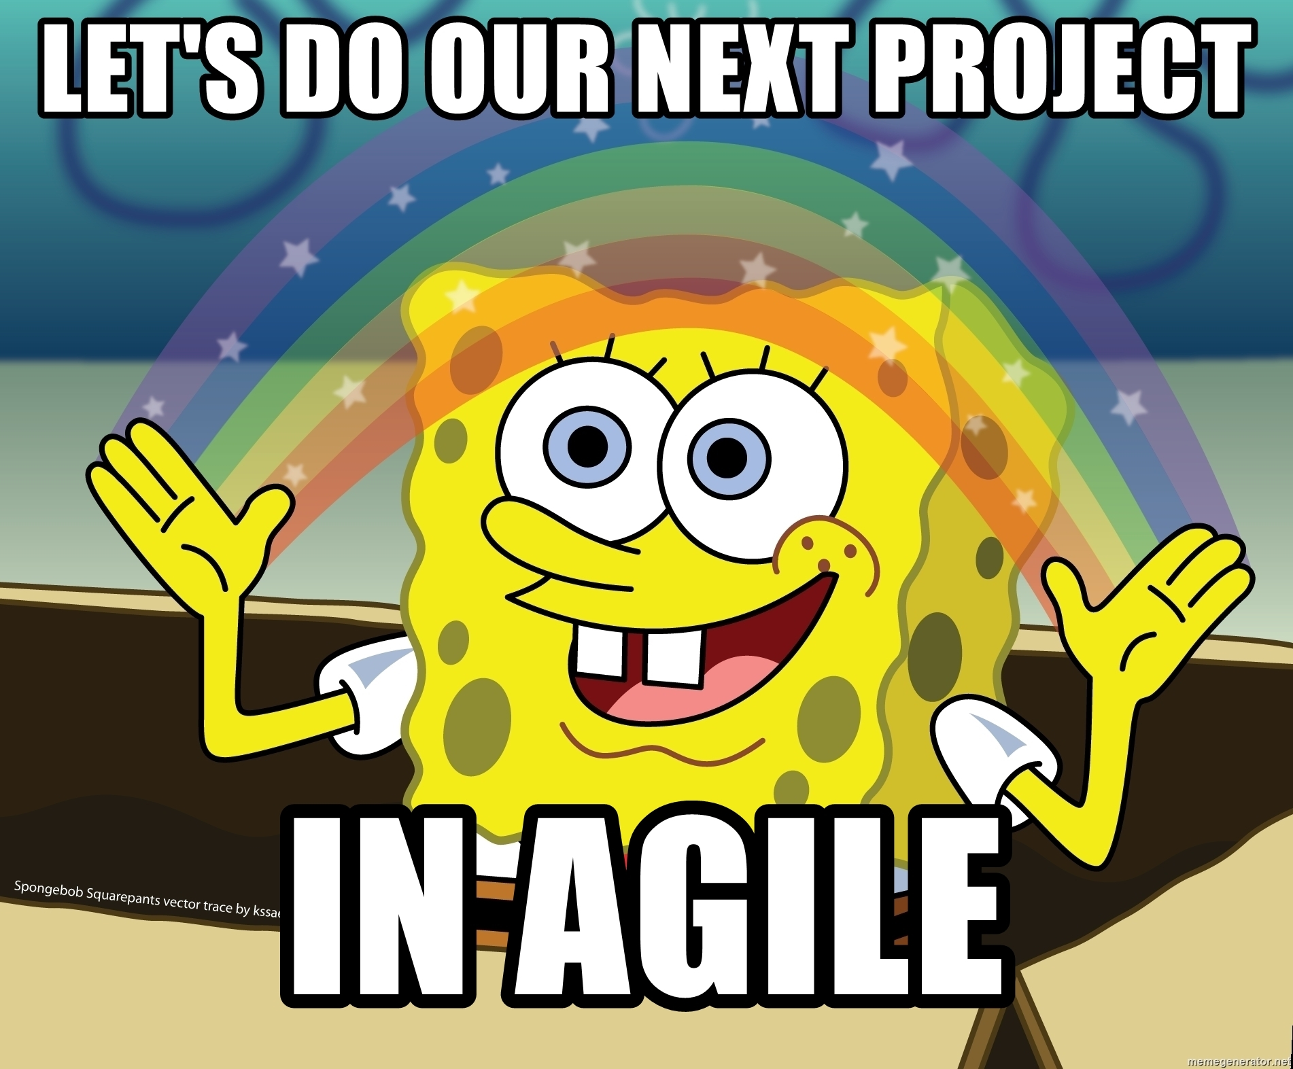
“In any given moment we have two options: to step forward into growth or to step back into safety.”
“Learn from yesterday, live for today, hope for tomorrow. The important thing is not to stop questioning.”
“Change will be incremental and take time.”
Failure is not fatal, but failure to change might be.”
“If you adopt only one agile practice let it be retrospectives. Everything else will follow.”
“Intelligence is the ability to adapt to change.”

